Slide 1
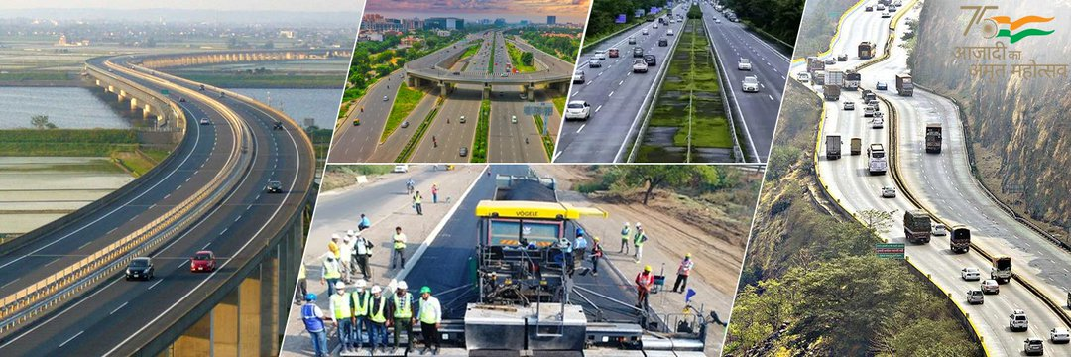
ROAD CONSTRUCTION & MAINTENANCE ROAD SURVEY & DESIGN TRAINING

Slide 2
CONTENT
classification with jurisdiction
classification with type of roads
CC
BT
RIGID Pavement
Flexible
widening
working out examples
Soil characteristics
CBR value
CC rd design BT rd design

Slide 3
ROAD
A way or path over which cyclists, vehicles and pedestrians can pass lawfully.
Roads are normally used for transportation within a country.

Slide 4
ADVANTAGES OF ROADS
Nearest to the man, as for going to airport, harbor or railway station.
Can be used by all types of vehicles from cycles to trailers.
Can lead to any remote area and road users have freedom of movement.
Vehicle movements are not time bound, roads are open to traffic for 24 hours.

Slide 5
ROADS BECOMING POPULAR…
1951- Rail: Road Passenger Transport Proportion was 62:38
1981- Rail: Road Passenger Transport Proportion became 20:80
At a time, Railway needs 2000 tonnes for economical transport
At a time, Road transport can be a truck or group of many. One truck carries just 10 tonnes.

Slide 6
ROADS BECOMING POPULAR…
Timings in case of Railways are fixed where they are flexible in case of road transport
The monopoly of Government is not present in Road transport
Suitable for personal travel
Cost of Construction- Roadways- Rs. 15-25 Lakhs/km, Railways- Rs. 30-60 Lakhs/km
Cost of Maintenance- Roadways- Rs. 10,000 to 15,000 /km, Railways- Rs. 1-2 Lakhs/km.

Slide 7
METHOD OF CLASSIFICATION
The roads are generally classified on the following basis:
Traffic Volume
Load Transported or Tonnage
Location and Function

Slide 8
ROAD CLASSIFICATION
NATIONAL HIGHWAYS (NH)
STATE HIGHWAYS (SH)
MAJOR DISTRICT ROADS (MDR)
OTHER DISTRICT ROADS (ODR)
VILLAGE ROADS (VR)

Slide 9
NATIONAL HIGHWAYS
They are main highways running through the length and breadth of India, connecting major ports, foreign highways, capital of large states and large industrial and tourist centres including roads required for strategic movements for the defence of India.

Slide 10
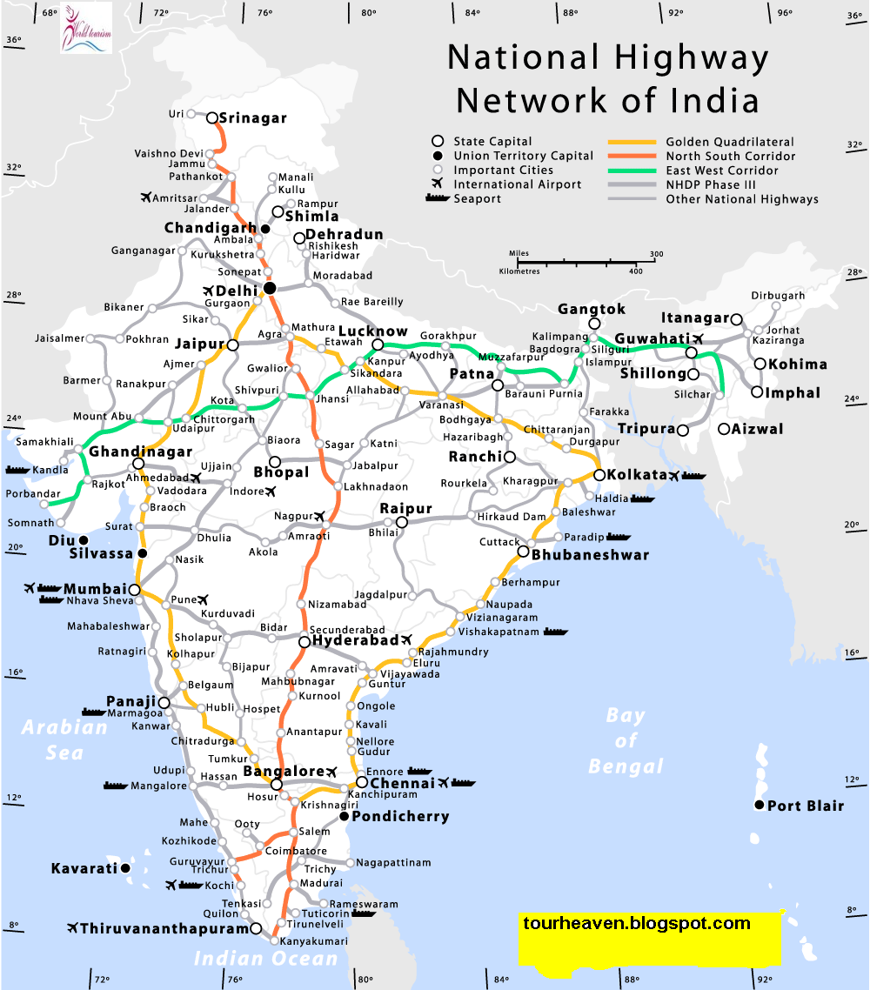

Slide 11
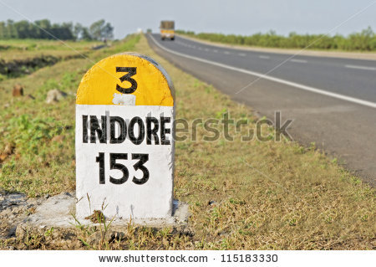

Slide 12
STATE HIGHWAYS
They are arterial roads of a state, connecting up with the national highways of adjacent states, district headquarters and important cities within the state and serving as the main arteries for traffic to and from district roads.

Slide 13
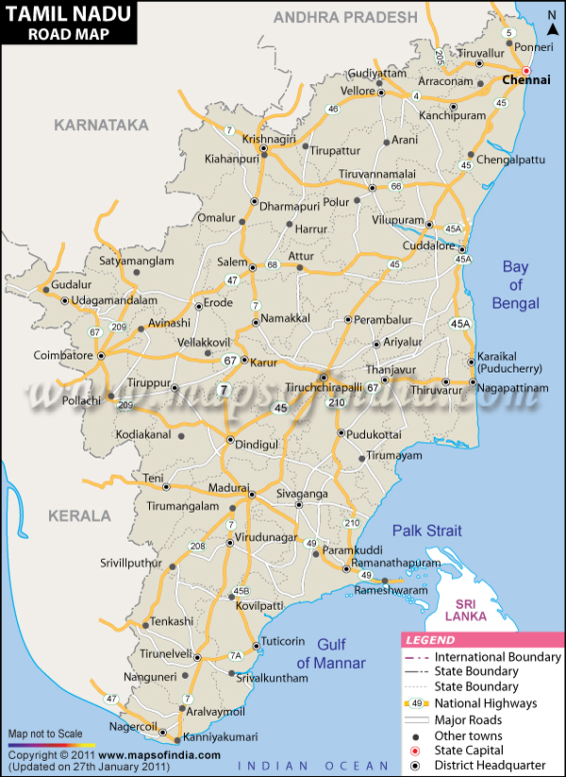

Slide 14
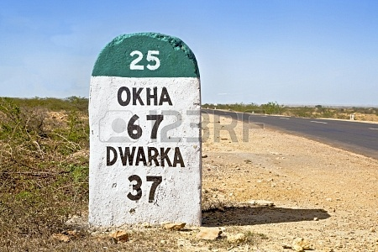

Slide 15
MAJOR DISTRICT ROADS
They are important roads within district serving areas of production and markets and connecting those with each other or with a main highway of a district. The MDR has lower speed and geometric design specification than NH/SH.

Slide 16
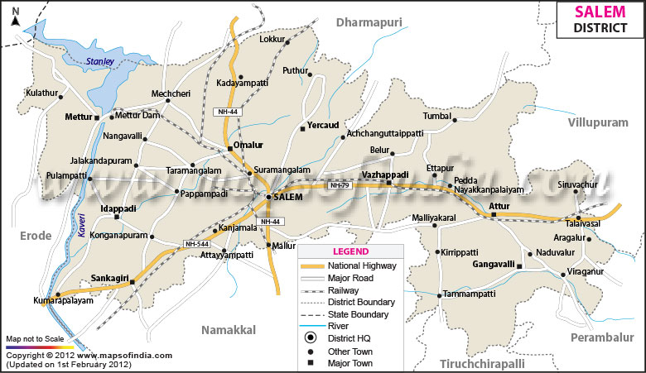

Slide 17
OTHER DISTRICT ROADS
They are serving rural areas of production and providing them with outlet to market centres, taluk head quarters, block development head quarters or other main roads. These are of lower design specification than MDR.

Slide 18
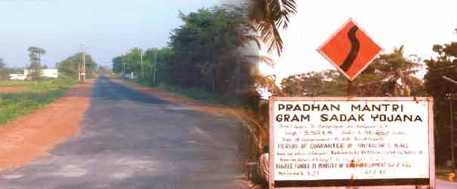

Slide 19
VILLAGE ROADS
They are roads connecting villages or group of villages with each other to the nearest road of a higher category.

Slide 20
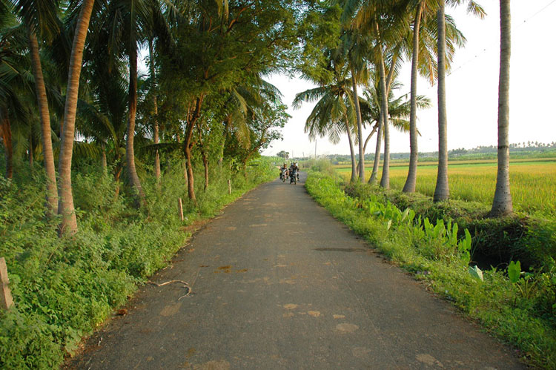

Slide 21
EXPRESSWAYS

Slide 22
EXPRESSWAYS
An expressway is a controlled-access highway; it is a highway that controls entrances to it and exits from it by incorporating the design of the slip roads for entry and exit into the design of the highway itself. Access-control should not be confused with collection of toll. An expressway may be free to use and may not collect toll at all.

Slide 23
EXPRESSWAYS
Expressways are the highest class of roads in the Indian Road Network. These are six- or eight-lane highways with controlled-access. India has approximately 942 km expressways. Currently, a massive project is underway to expand the highway network and the Government of India plans to add an additional 18,637 km (11,580 mi) of expressways to the network by the year 2022.

Slide 24
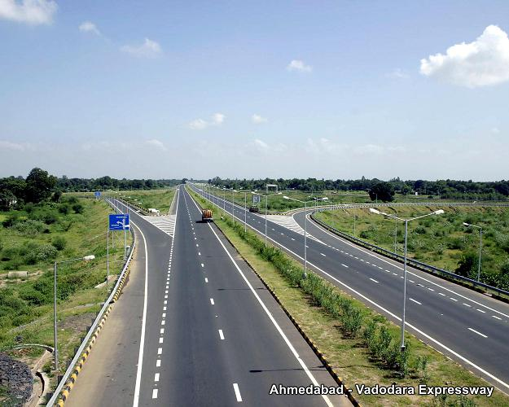

Slide 25
CLASSIFICATION OF URBAN ROADS
The urban roads are classified as:
Arterial Roads
Sub-arterial roads
Collector Streets
Local Streets

Slide 26
ARTERIAL STREETS
For the heavy/important traffic inside the city
Usually along the expressways serving as principal network of traffic flow
Join central business district with outside residential areas
Parking, loading, unloading prohibited
Pedestrians are allowed to cross only at intersections

Slide 27
SUB-ARTERIAL STREETS
Less traffic than arterial streets
Pedestrians are allowed to cross only at intersections
Spacing varies from 0.5 km in central business areas to 3 to 5 km in residential area.
Parking, loading, unloading usually restricted and controlled

Slide 28
COLLECTOR’S STREETS
Meant for collecting the traffic from local streets to arterial streets
Full access allowed from properties alongside
Situated in residential, commercial, industrial areas
Few parking restrictions except for peak hours

Slide 29
LOCAL STREETS
Open access from residents, business or other properties
Does not carry large volume of traffic
Unrestricted parking and pedestrians allowed

Slide 30
GENERAL STAGES OF ROAD PLANNING
Survey & Design is required mainly to address the following points; not necessarily limited to:
Cost Optimization
Fairly accurate cost estimation
To decrease time of construction so that benefit to the road user is achieved earlier than expected.
Attach engineering attributes and geometrics such as stability, gradient, water management, curvature, super elevation, width, structures etc.
Comfort and aesthetic realization
Employment generation and environment protection etc

Slide 31
GENERAL STAGES OF ROAD PLANNING
Some of the governing principles that are required to be considered during desk top study are:
The alignment should take into account all the control points and should be shortest and economical.
Marshy areas, steep terrain, landslide, unstable hill features etc should be avoided. Stereographic use of aerial photographs are recommended.
Need of connecting important villages and towns
Bridge site locations

Slide 32

GENERAL STAGES OF ROAD PLANNING
Map study is carried out using available topographical map and now a days using google earth from internet. 2 or 3 alternative alignments are marked on the topo map between two known points i.e takeoff and terminal points. The gradient of the alignment in the map is maintained by the distance of crossing point between one contour to another contour. It is determined by the simple equation;
X =

Slide 33
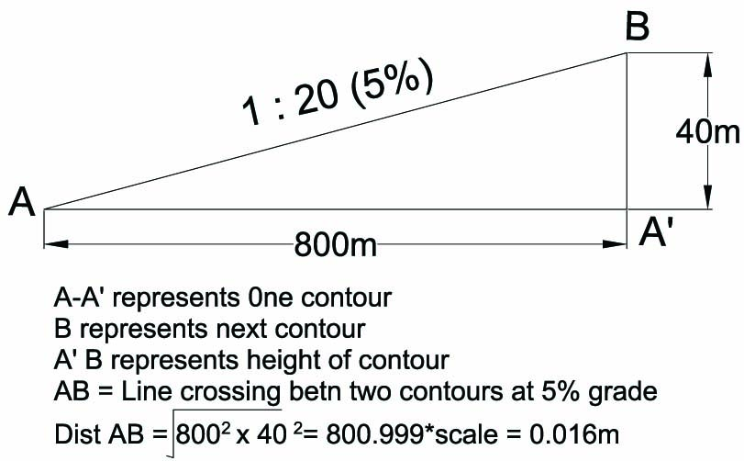
GENERAL STAGES OF ROAD PLANNING
Example
Contour interval = 40m
Gradient required = 5% (0.05)
Scale of the map = 1/50000
Distance X = (40/0.050)*1/50000
= 0.016m
= 1.6cm
Therefore, the second contour will be crossed at the distance of 1.6cm from first contour which will give 5% slope / gradient

Slide 34
GENERAL STAGES OF ROAD PLANNING
Feasibility Study Report
In conjunction with ground reconnaissance survey, other assessment such as social assessment, environmental assessment, geotechnical assessment etc. are also carried out. Based on the information collected during the ground reconnaissance survey, a report should be prepared.
The report should include all relevant information including a map/plan showing alternative alignments with their rough cost estimates. The report should discuss advantageous and disadvantageous of different alternatives to help the selection of most suitable alignment. The feasibility team should put up their recommendations based on their judgment and knowledge.

Slide 35
GENERAL STAGES OF ROAD PLANNING
Alignment fixing survey (Ghat Tracing survey)
Based on the feasibility study report, the authority will approve one suitable alignment. This alignment which is approved for adoption will have to be transferred to the ground. This is done by fixing the wooden pegs at an interval of 20m with the help of clinometers or abney level and measuring tape. It is suppose to be an approximate center line having a gradient that is given in the feasibility report.
Each alignment peg should contain the information such as chainage and gradient. This phase of survey, though simple is considered to be very important. It should be usually carried out by experienced survey engineer or civil engineer. Once this phase of survey is completed, change of alignment in future is very difficult.
During this phase of survey, the data recorded are: Exact length of road, number of cross drainages required, number of hairpin bends introduced, gradient adopted, soil classification, bridge points and its span etc. A brief report shall be submitted where concern authority will instruct to carry on with further survey works which is called detail survey.

Slide 36
GENERAL STAGES OF ROAD PLANNING
Detail Survey using Total Station
Detail survey which is also known as topographic survey will commence immediately using total station instrument. Collection of topographic data is carried out along the proposed road corridor in combination with traverse survey. In order to attain the line of sight any obstructions such as bushes and small trees should be cleared.
The corridor of about 50m ie 30m towards hill side and 20m towards valley side of centerline should be made visible to the survey instrument. The data that are collected during detail survey phase are : All topographic features such as gullies, ridge, natural surface, change of grade, any man made features, cliff, boundary pillars, fence, cultivated land, Ghat tracing pegs, prominent trees etc.
For future references at least 2 nos. of traverse stations per km of alignment shall be made permanent. This type of survey is very time consuming but unavoidable and without which geometric design is not possible. This type of survey demand use of other associated equipment such as computer, generators if electricity is not available. The data that is collected during such detail survey is downloaded to the computer using appropriate software and then handed over to design engineers.

Slide 37
GENERAL STAGES OF ROAD PLANNING
Detail Road Design
Geometric design is carried out based on the detail survey data collected earlier. The parameters that are considered in geometric design are: Classification of Road, Design Speed, Horizontal Alignment, Formation & Cross Section, Sight Distance, Super elevation, Vertical Alignment, Gradient etc. Geometric design is carried out using computer software such as MXROAD, Geocomp etc. The designer is required to visit the site for verification of his/her preliminary design before the finalizing the design.
Necessary drawings and set out data are produced. Drawings include Plan, longitudinal section, cross section to the required scale. Cross sections are generally taken at 20m interval for straight sections and more close for curve sections. Set out data such as station set out, centerline set out, batter set out, earthwork quantities etc are produced.
Environment friendly road construction technique to be adopted in the geometric design through optimization of cut and fill involved in the earthworks. Environment friendly road design aptly demonstrates that a slight shift of the centerline to the valley side can result in substantial reduction of earthworks and height of hill side cut

Slide 38
ROAD DESIGN
MATERIAL SURFACE TYPE | PAVEMENT | SHOULDER CROSSFALL
 | CROSSFALL
Earth, Loam | 5% | 6%
Gravel, Waterbound Macadam | 3 - 4 % | 5%
Bitumen seal coat | 2.5 - 3 % | 4%
Dense bituminous premix or ridge pavement | 2 – 3 % | 3%
Super elevation | 8% | 8%

Slide 39
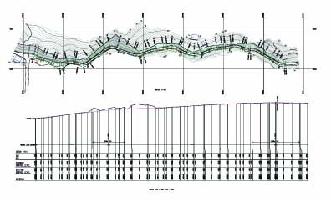
DRAWINGS (PLAN & L-SECTION)

Slide 40
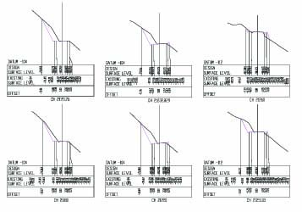
DRAWING (CROSS SECTION)

Slide 41
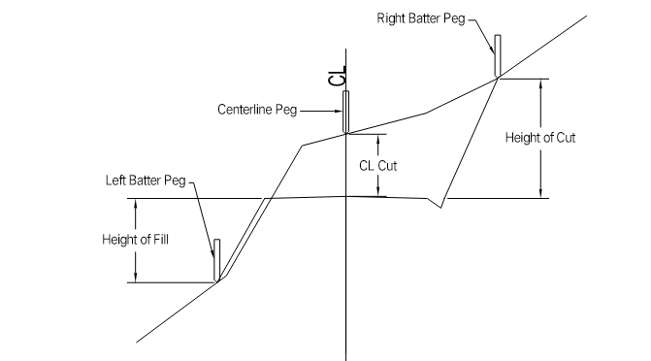
GENERAL STAGES OF ROAD PLANNING
Setting out the alignment (Batter Pegging)
The purpose of set out survey is to lay out the final centerline of the road based on the centerline fixed in the design office. Two main operations involved in this survey is fixing centerline and batter pegs to guide the construction team. Both the pegs are fixed at 20m interval with information such as chainage, gradient, cut and fill etc. are written on it. All such pegs should be protected. See drawing in next slide.

Slide 42
PAVEMENT DESIGN
Design of pavement for roads, whether in plains or hills follow the same basic principles like:
Soil properties
Traffic parameters
And also climatic conditions

Slide 43
TYPE OF PAVEMENT
Rigid Pavement
Flexible Pavement
Composite Pavement

Slide 44
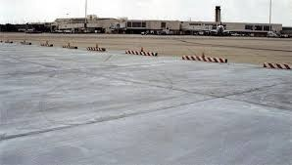
RIGID PAVEMENT

Slide 45
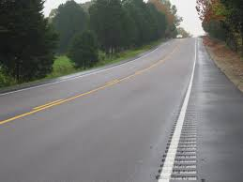
FLEXIBLE PAVEMENT

Slide 46
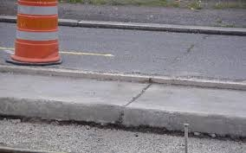
COMPOSITE PAVEMENT

